Slide 1


PyMOL and Foldit
Nov 17 2020

Slide 2

No app does it all
PyMOL
Foldit
Rosetta
Visualization
Design
(borrowed liberally from Ian Haydon)

Slide 3
No app does it all
PyMOL
Foldit
Rosetta
Visualization
Design
(borrowed liberally from Ian Haydon)

Slide 4
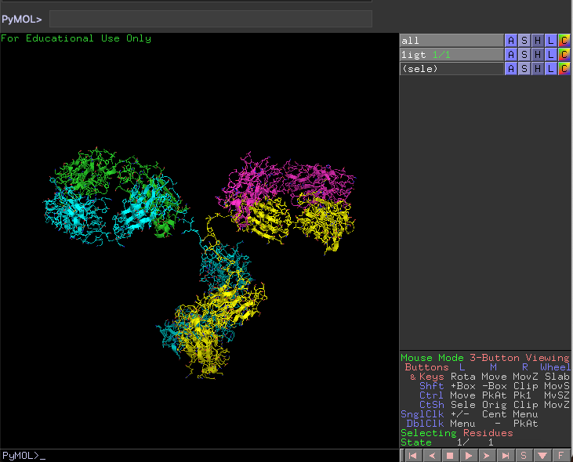
PyMOL is great for protein visualization

Slide 5
PyMOL is great for protein visualization
Command-line

Slide 6
PyMOL is great for protein visualization
Command-line
Pre-set commands

Slide 7
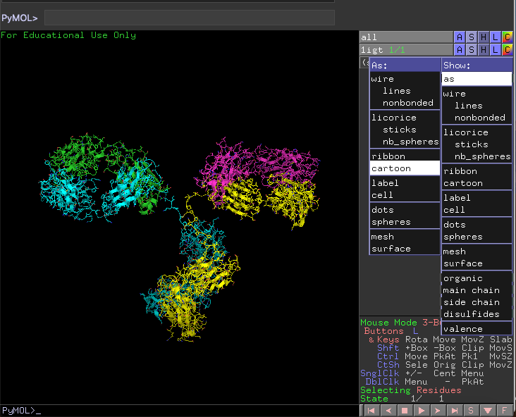
PyMOL is great for protein visualization
Command-line
Pre-set commands

Slide 8
PyMOL is great for protein visualization
Command-line
Pre-set commands
Adjust selection mode

Slide 9
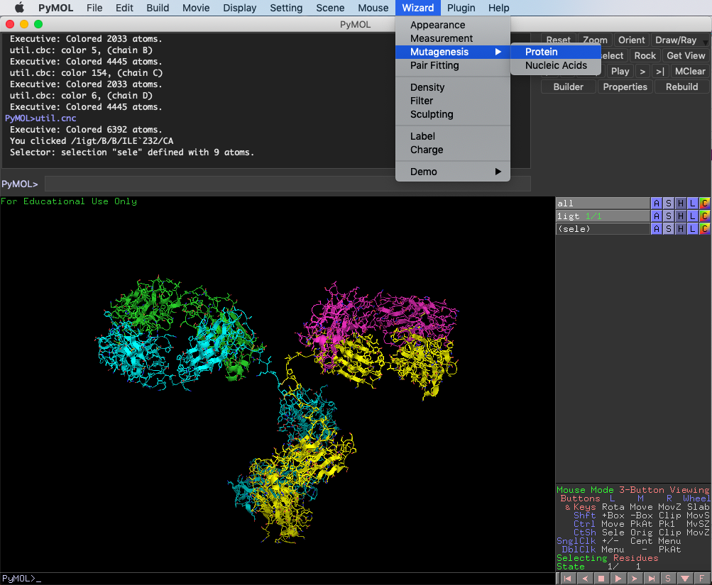
PyMOL is great for protein visualization
Command-line
Pre-set commands
Adjust selection mode
Additional options (Measurement, Mutagenesis can be helpful)

Slide 10
PyMOL command-line getting started
Commands to get started
#grabs PDB based on 4-char id
fetch 1igt

Slide 11
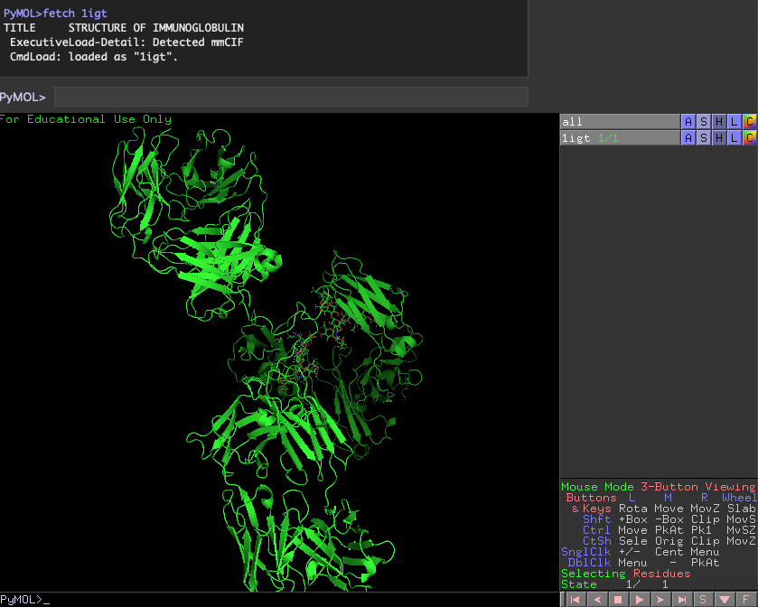
PyMOL command-line getting started
Commands to get started
#grabs PDB based on 4-char id
fetch 1igt

Slide 12
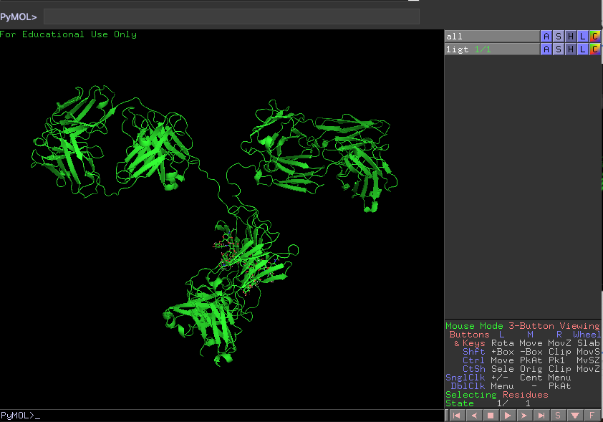
PyMOL command-line getting started
Commands to get started
#grabs PDB based on 4-char id
fetch 1igt
move camera: (not command-line)
left-click: rotate
middle-click: up/down/left/right
right-click: back/forth

Slide 13
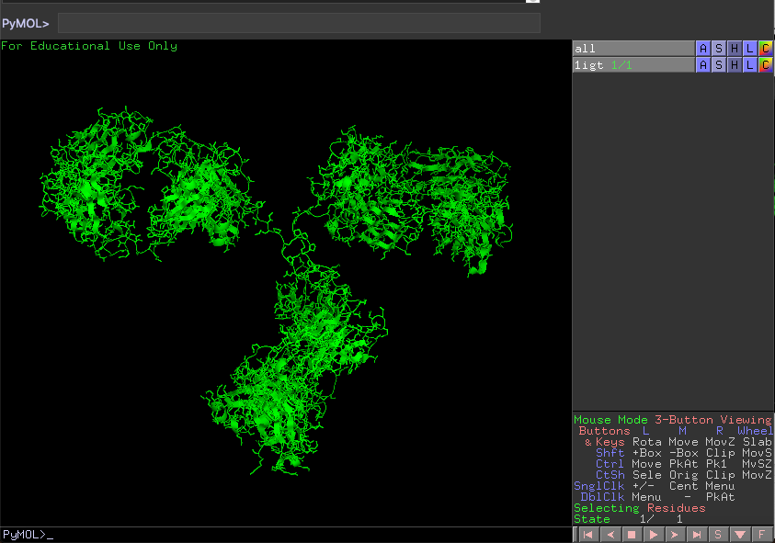
PyMOL command-line getting started
Commands to get started
#grabs PDB based on 4-char id
fetch 1igt
#changes the representation
hide all
show cartoon
show sti, !hydr

Slide 14
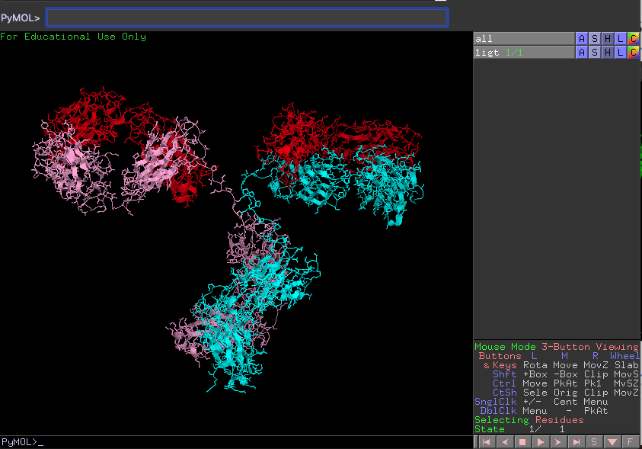
PyMOL command-line getting started
Commands to get started
#grabs PDB based on 4-char id
fetch 1igt
#changes the representation
hide all
show cartoon
show sti, !hydr

Slide 15
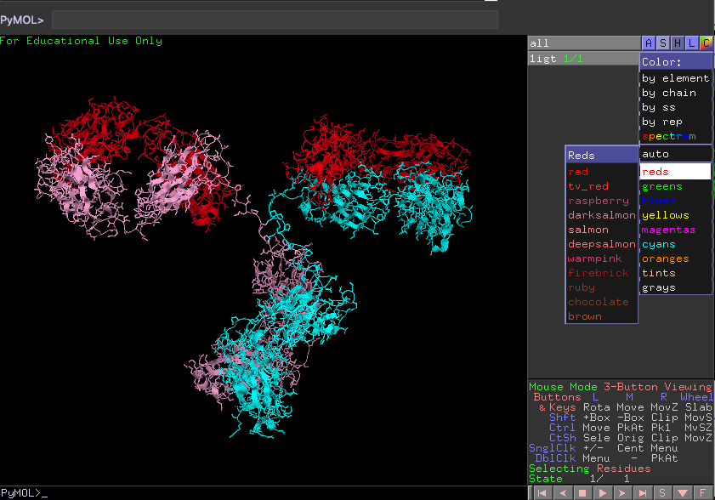
PyMOL command-line getting started
Commands to get started
#grabs PDB based on 4-char id
fetch 1igt
#changes the representation
hide all
show cartoon
show sti, !hydr
#changes colors
color cyan
color red, chain A+C
color pink, chain B and 1igt
(can also be changed in drop-down)

Slide 16
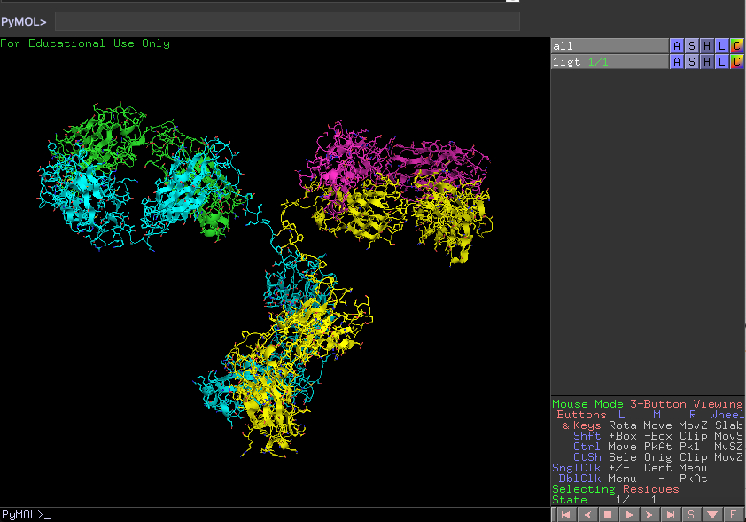
PyMOL command-line getting started
Commands to get started
#grabs PDB based on 4-char id
fetch 1igt
#changes the representation
hide all
show cartoon
show sti, !hydr
#changes colors
color cyan
color red, chain A+C
color green, chain B and 1igt
util.cbc #colors by chain
util.cnc #colors by atom

Slide 17
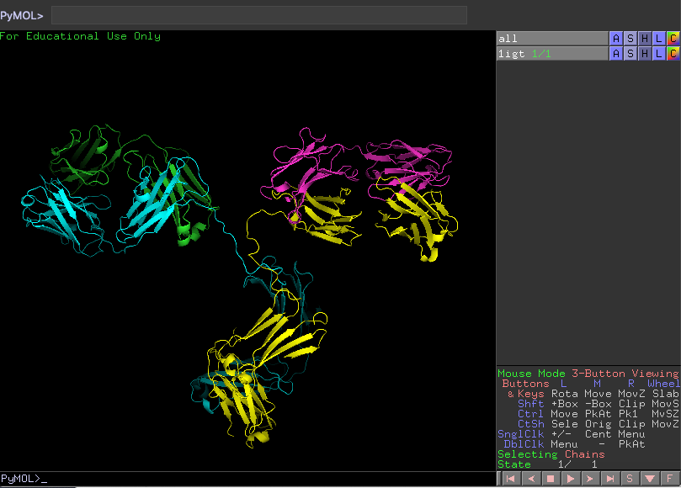
PyMOL command-line getting started
Commands to select parts of protein
Adjust selection mode

Slide 18
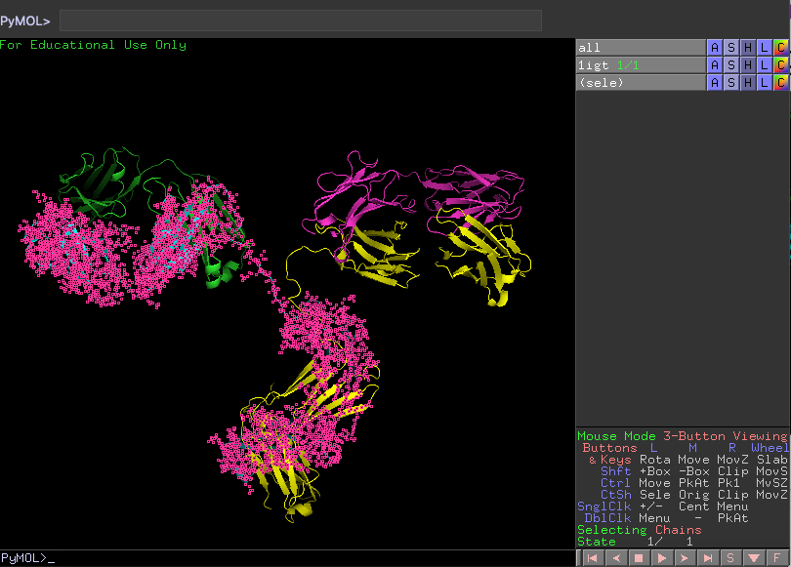
PyMOL command-line getting started
Commands to select parts of protein
Adjust selection mode
#can now apply other commands
#using sele
color red, sele
show sti, sele
hide lines, sele

Slide 19
PyMOL command-line getting started
Commands to select parts of protein
Adjust selection mode
#can now apply other commands
#using sele
color red, sele
show sti, sele
hide lines, sele
#can also select residues or chain
#in command line
select resi 1-207
select chain A
select chain A+B
select resi 1-207 and chain A

Slide 20
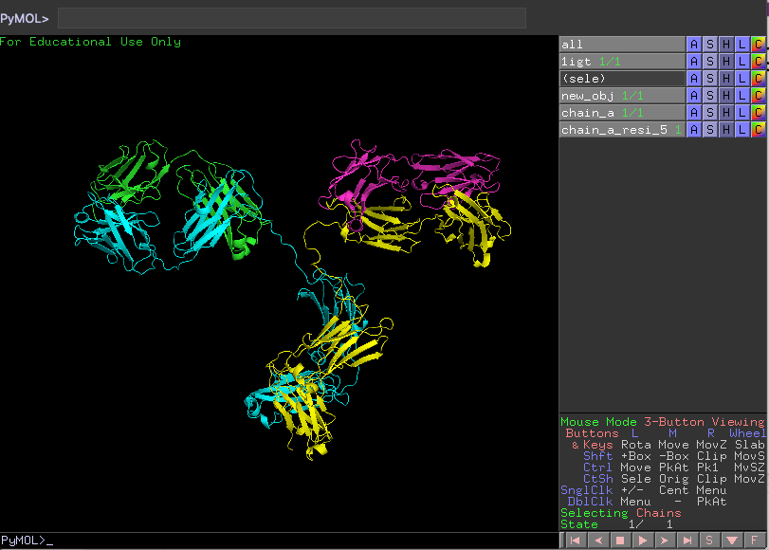
PyMOL command-line getting started
Commands to create new objects
create new_obj, sele
create chain_a, chain A
create a_r5, chain A + resi 5
#usage: create NEWNAME SELECTION
(new objects can be seen on the right)

Slide 21
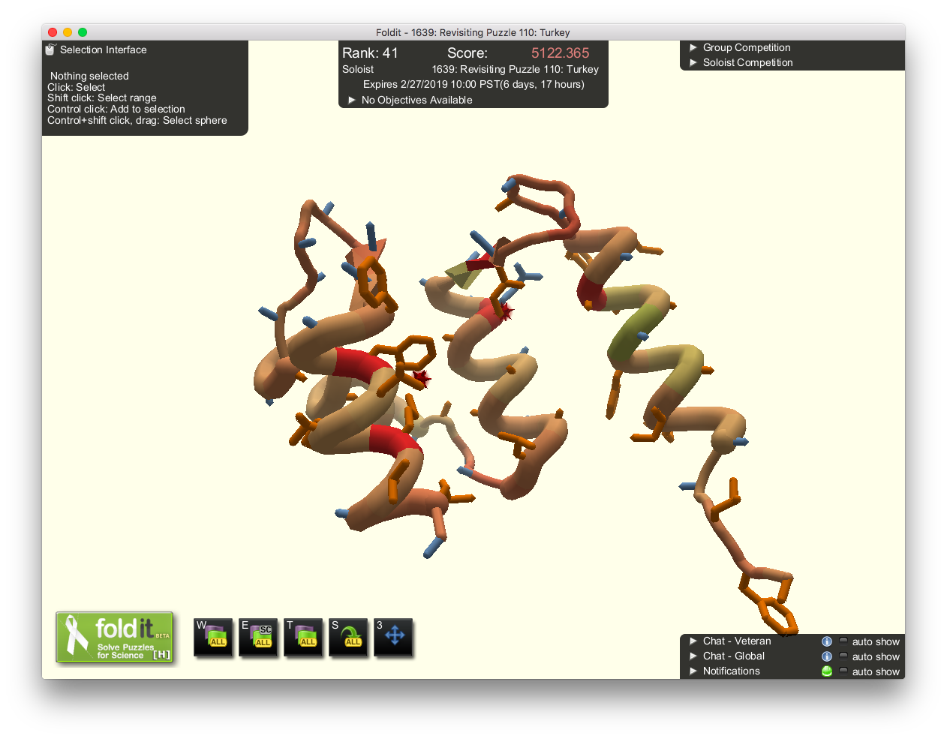

Foldit: A tool to visualize & design proteins
(borrowed liberally from Brian Koepnick)
Cooper, S. et al. Nature 466, 756–760 (2010).
Notes:
Alternatively, can use crowdsourcing
Free, online computer game for crowdsourcing protein modeling
Players compete to find low-energy models
Premise is that humans may have some intuition for efficient sampling
Previous successes...

Slide 22
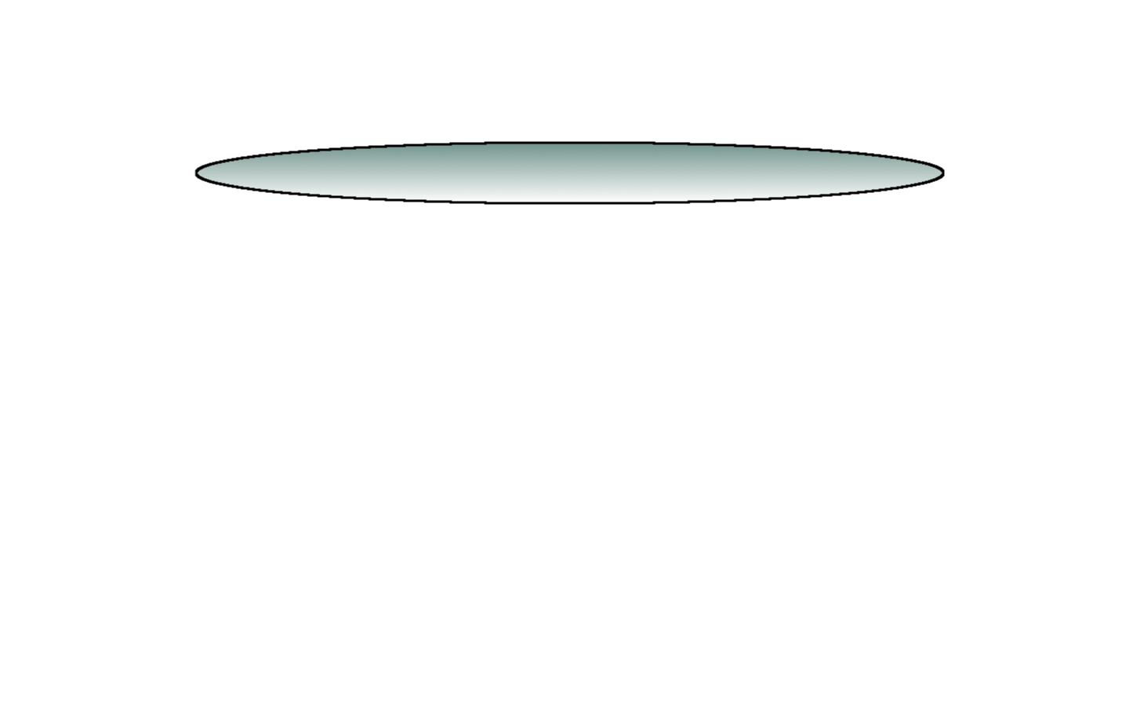
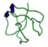
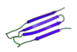
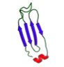

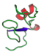
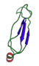
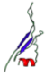
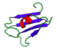
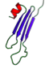
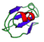
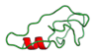
Foldit: folds proteins to find energy minima
>protein_sequence
TELEKHREELKEFLKKEGITNVEIRIDNGRLEVRVEGGTERLKRFLEELRQKLEKKGYTVDIKIE
(borrowed liberally from Brian Koepnick)
Notes:
How does a protein know what structure to fold to?
Imagine array of all possible structures
Calculate the energy from all the interactions in each structure

Slide 23
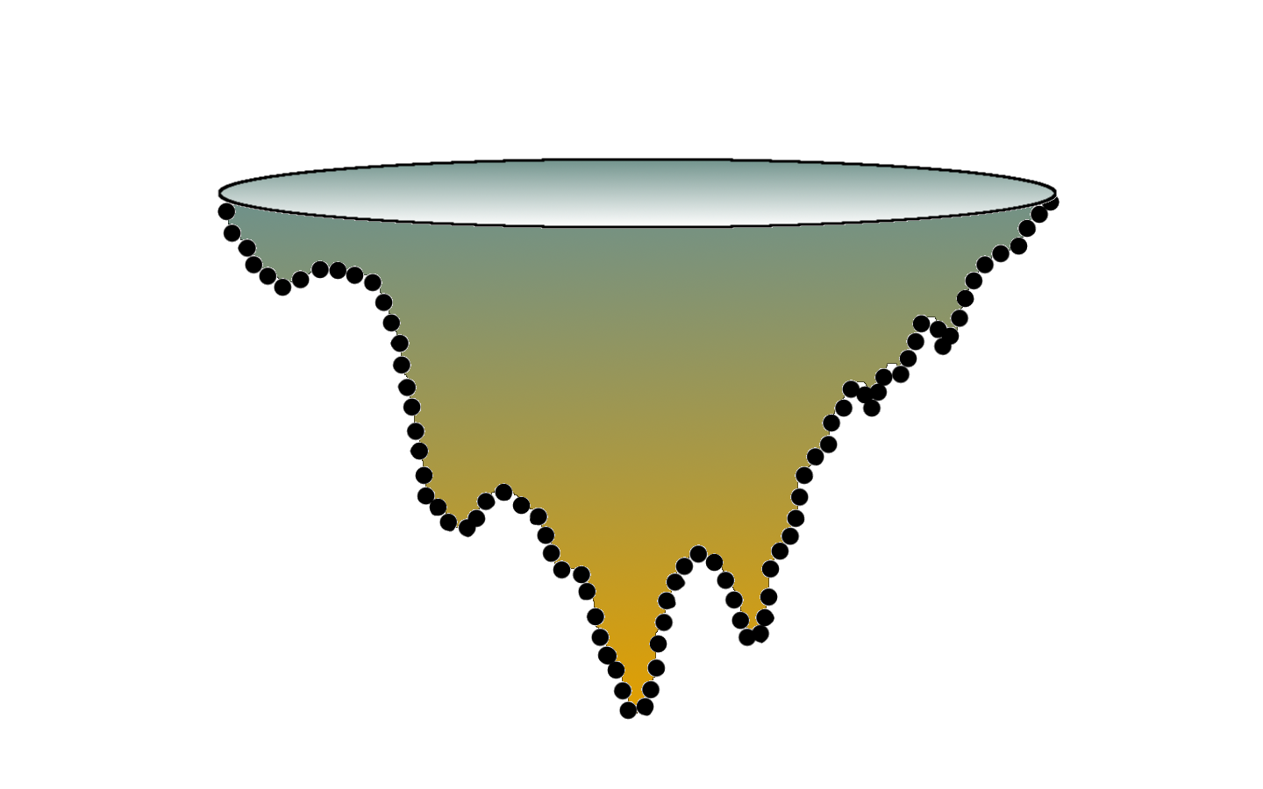
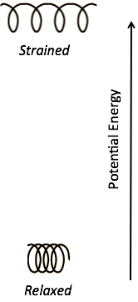
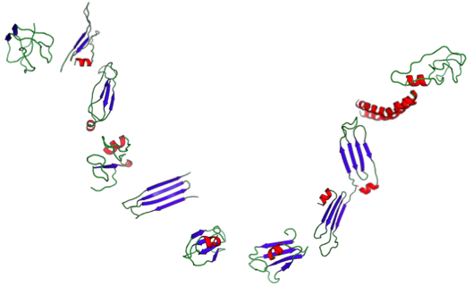
Foldit: folds proteins to find energy minima
>protein_sequence
TELEKHREELKEFLKKEGITNVEIRIDNGRLEVRVEGGTERLKRFLEELRQKLEKKGYTVDIKIE
(borrowed liberally from Brian Koepnick)
Notes:
Energy landscape
Lower points have lower energy (more relaxed)
This energy landscape has a global minimum
Protein naturally collapses to lowest energy structure
Landscape helps us think about problem of protein structure prediction
We want to predict the 3D structure to better understand its function
Problem is protein space is vast, intractable to enumerate every possible structure

Slide 24
Foldit: folds proteins to find energy minima
Foldit:
is a video game interface
uses Rosetta energy calculations to evaluate protein structures
can be used to design proteins
can be used to evaluate protein mutation effects on total energy & structure
(borrowed liberally from Brian Koepnick)
Notes:
Alternatively, can use crowdsourcing
Free, online computer game for crowdsourcing protein modeling
Players compete to find low-energy models
Premise is that humans may have some intuition for efficient sampling
Previous successes...

Slide 25
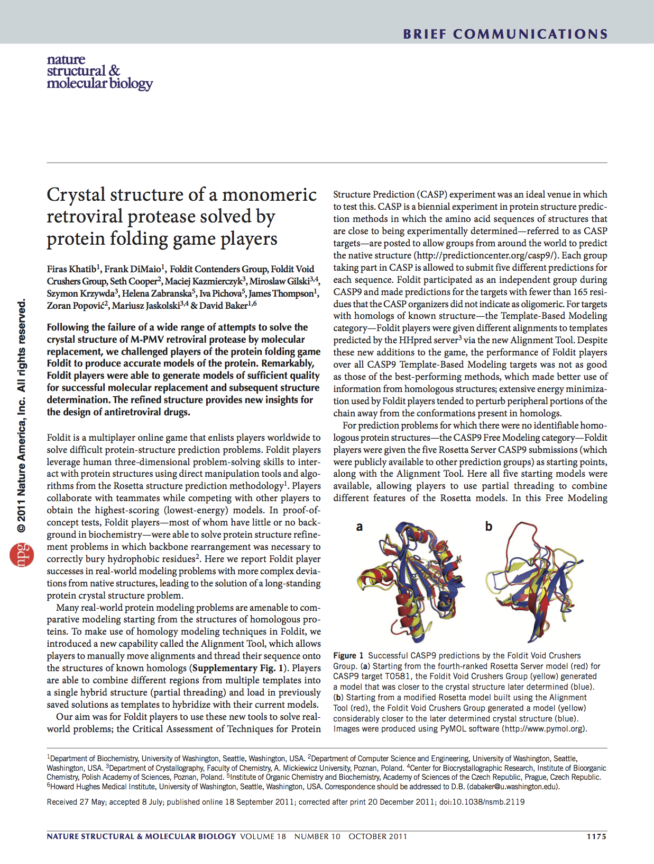
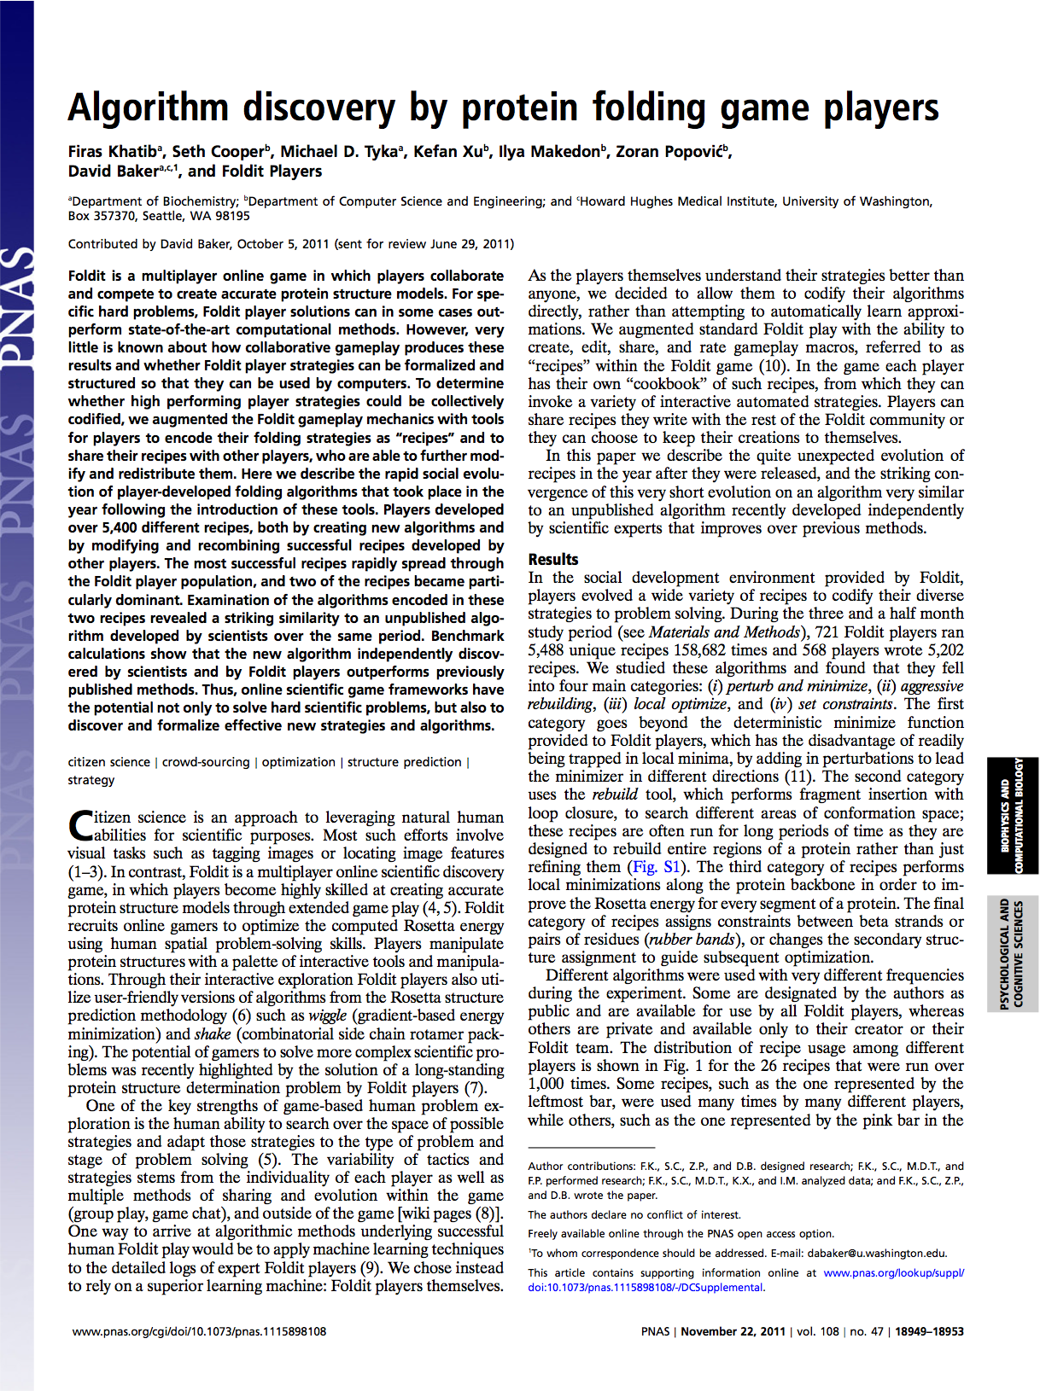
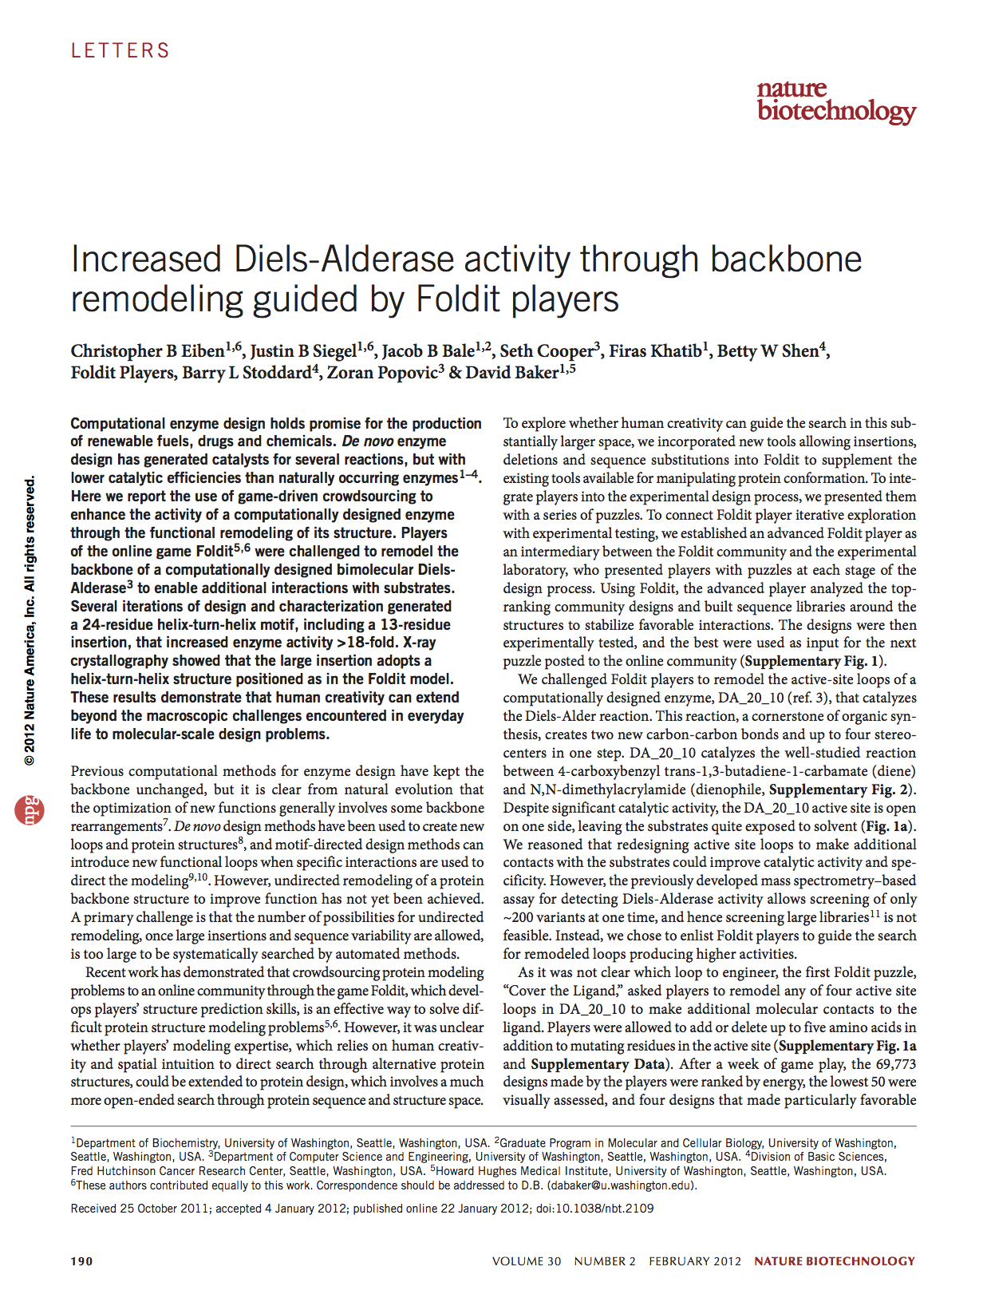
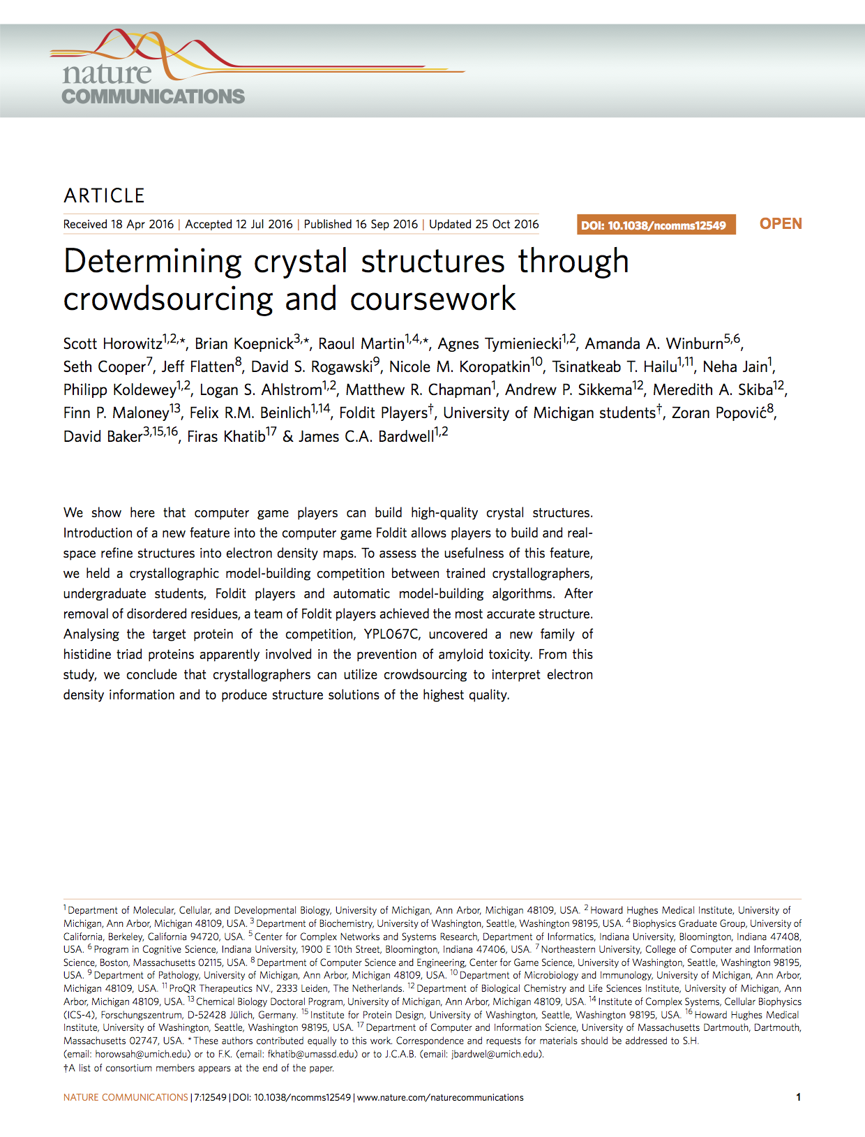
Foldit: folds proteins to find energy minima
Foldit:
is a video game interface
uses Rosetta energy calculations to evaluate protein structures
can be used to design proteins
can be used to evaluate protein mutation effects on total energy & structure
has been successfully used to design real-life & novel proteins
Khatib, F. et al. Nat. Struct. Mol. Biol. 18, 1175–1177 (2011).
Khatib, F. et al. Proc. Natl. Acad. Sci. U. S. A. 108, 18949–18953 (2011).
Eiben, C. B. et al. Nat. Biotechnol. 30, 190–192 (2012).
Horowitz, S. et al. Nat. Commun. 7, 12549 (2016).
(borrowed liberally from Brian Koepnick)
Notes:
Alternatively, can use crowdsourcing
Free, online computer game for crowdsourcing protein modeling
Players compete to find low-energy models
Premise is that humans may have some intuition for efficient sampling
Previous successes...

Slide 26
Foldit: folds proteins to find energy minima
Foldit:
is a video game interface
uses Rosetta energy calculations to evaluate protein structures
can be used to design proteins
can be used to evaluate protein mutation effects on total energy & structure
has been successfully used to design real-life & novel proteins
Pymol:
is good for visualizing complex proteins
has limited design functionality
is good for loading & comparing multiple structures
has more options for protein representations
is the standard protein visualization software in the IPD
Cooper, S. et al. Nature 466, 756–760 (2010).
Notes:
Alternatively, can use crowdsourcing
Free, online computer game for crowdsourcing protein modeling
Players compete to find low-energy models
Premise is that humans may have some intuition for efficient sampling
Previous successes...

Slide 27
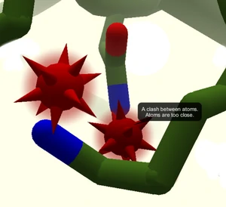
Definitions & Jargon
General definitions
Clash: atoms overlapping in space
Hydrogen-bond: ?

Slide 28
Definitions & Jargon
General definitions
Clash: atoms overlapping in space
Hydrogen-bond: non-covalent electrostatic interactions
Hydrophobic: ?

Slide 29
Definitions & Jargon
General definitions
Clash: atoms overlapping in space
Hydrogen-bond: non-covalent electrostatic interactions
Hydrophobic: think nonpolar, not favorable energetically in polar solvent
Packing: How closely sidechains fit together
We want to remove “voids” without clashing!

Slide 30
Definitions & Jargon
General definitions
Clash: atoms overlapping in space
Hydrogen-bond: non-covalent electrostatic interactions
Hydrophobic: think nonpolar, not favorable energetically in polar solvent
Packing: How closely sidechains fit together
We want to remove “voids” without clashing!
Score: based on Rosetta energy function, which estimates delta G
In Foldit, we want a high total score
In Rosetta (/real life), happy proteins have low delta G

Slide 31
Definitions & Jargon
General definitions
Clash: atoms overlapping in space
Hydrogen-bond: non-covalent electrostatic interactions
Hydrophobic: think nonpolar, not favorable energetically in polar solvent
Packing: How closely sidechains fit together
We want to remove “voids” without clashing!
Score: based on Rosetta energy function, which estimates delta G
In Foldit, we want a high total score
In Rosetta (/real life), happy proteins have low delta G
Void: Empty space in the protein core

Slide 32
Definitions & Jargon
General definitions
Clash: atoms overlapping in space
Hydrogen-bond: non-covalent electrostatic interactions
Hydrophobic: think nonpolar, not favorable energetically in polar solvent
Packing: How closely sidechains fit together
We want to remove “voids” without clashing!
Score: based on Rosetta energy function, which estimates delta G
In Foldit, we want a high total score
In Rosetta (/real life), happy proteins have low delta G
Void: Empty space in the protein core
Foldit definitions
Shake: move protein sidechains to optimize energy
Wiggle: move protein backbone & sidechains to optimize energy

Slide 33
Definitions & Jargon
General definitions
Clash: atoms overlapping in space
Hydrogen-bond: non-covalent electrostatic interactions
Hydrophobic: think nonpolar, not favorable energetically in polar solvent
Packing: How closely sidechains fit together
We want to remove “voids” without clashing!
Score: based on Rosetta energy function, which estimates delta G
In Foldit, we want a high total score
In Rosetta (/real life), happy proteins have low delta G
Void: Empty space in the protein core
Foldit definitions
Shake: move protein sidechains to optimize energy
Wiggle: move protein backbone & sidechains to optimize energy
Wiggle or shake could resolve this clash & optimize packing!

Slide 34
Homework for this week
Download Foldit & set up your account
Progress through the tutorials
Go through (at least) “Wiggle!”
Download pymol and get an academic license to activate

Slide 35
Homework for this week
Download Foldit & set up your account
Progress through the tutorials
Go through (at least) “Wiggle!”
Download pymol and get an academic license to activate
Later in the week we will send you your nanocage for the rest of the project-- see if you can extract and save a PDB file of just chain A!

